Slide 1

2030
Analysis of Glassdoor Rating and Reviews

Slide 2
1
Problem Statement
2
Overall Trend
Company Rating Analysis
Company Reviews Analysis
CONTENT
3
4
5
Conclusion
6
Demo of RShiny

Slide 3
PART
01
Problem Statement

Slide 4
Problems
Problems 1 | Problem 2 | Problem 3
Aggregated rating does not provide insights into company reviews | Glassdoors API is not publicly available | Few comprehensive researches on Glassdoor ratings and reviews.
Purpose
Individuals | Companies
Position themselves to be an informed candidate in their job search | Reflect ratings and reviews; Concerted effort to improve culture of companies to attract talents and increase productivity of employees
文字添加
此处
Notes:
As of 2020, the number of companies on Glassdoor reached 1 million, with their ratings and reviews totalling 55 million. These ratings and reviews provide valuable insights such as jobs, salaries, and insights into a company’s culture. https://expandedramblings.com/index.php/numbers-15-interesting-glassdoor-statistics/

Slide 5
PART
02
Overall Rating Trend

Slide 6
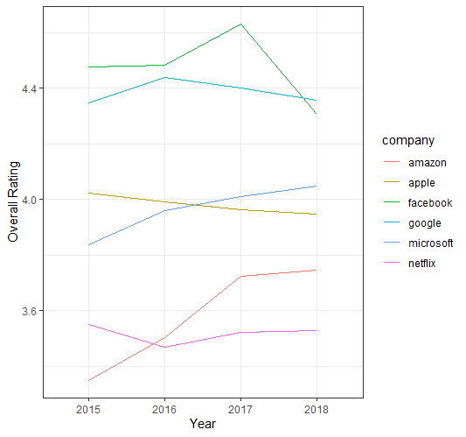
Overall Rating Trend
Facebook
Decreasing Tend from 2015 – 2018
Sharp decline from 2017 - 2018
Amazon
Increasing Trend from 2015 – 2018
Sharp increase from 2015 - 2017

Slide 7
PART
03
Company Rating Analysis
Introduction
Correlation
Multiple Linear Regression

Slide 8
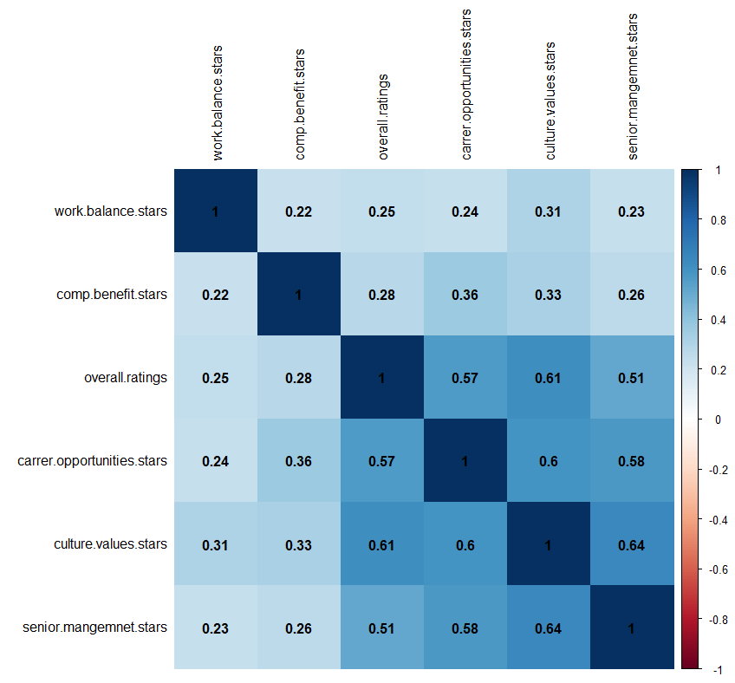
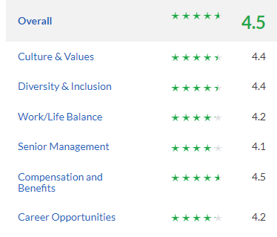
Ratings and Correlation
Strong correlation between Culture & Values and Overall rating (0.61)
Followed by
Career Opportunities
Senior Management
Compensation and Benefit
Work/Life Balance
文字添加
此处
文字添加
此处
文字添加
此处
Notes:
career opportunities, senior management, company benefit then work balance

Slide 9
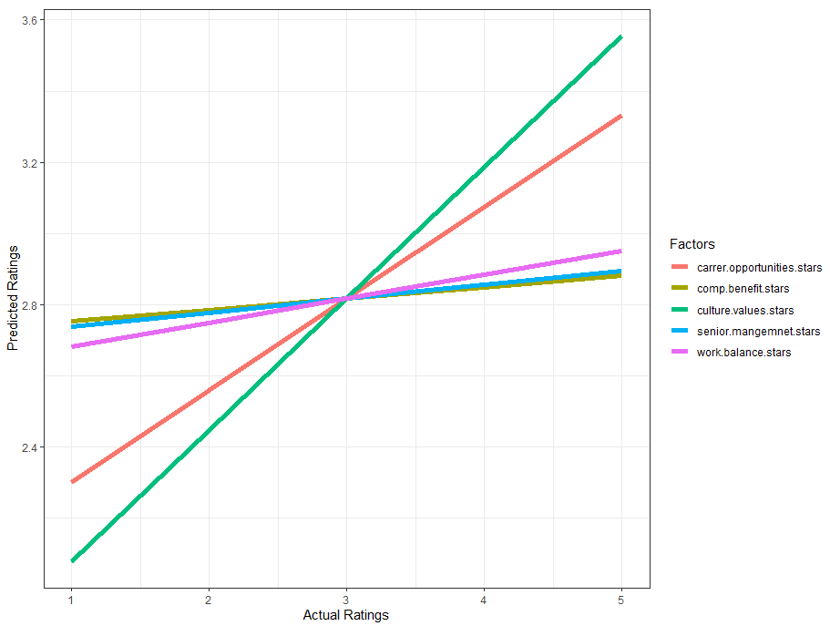
Multiple Linear Regression
“Culture” and “Career Opportunities” contribute greatly to the company’s ratings compared to other 3 factors
The steeper the gradient, the more the factor contributes to the actual ratings.
文字添加
此处
Interaction between factors

Slide 10
PART
04
Company Reviews Analysis
Introduction
Word Cloud
Linear Regression

Slide 11
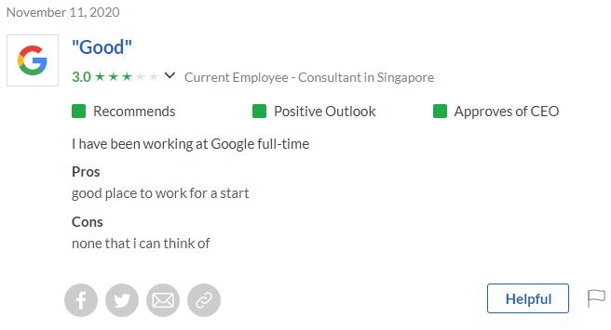
Introduction
Web Scraping
Generate Word Cloud
Conduct Sentiment Analysis based on AFINN Lexicon with integer between -5 (negative) and +5 (positive)
文字添加
此处
文字添加
此处
文字添加
此处
Notes:
The AFINN lexicon is a list of English terms manually rated for valence with an integer between -5 (negative) and +5 (positive) by Finn Årup Nielsen between 2009 and 2011.

Slide 12
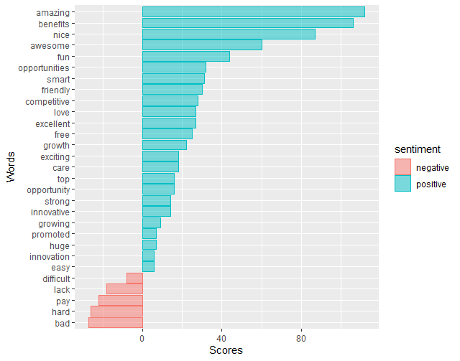
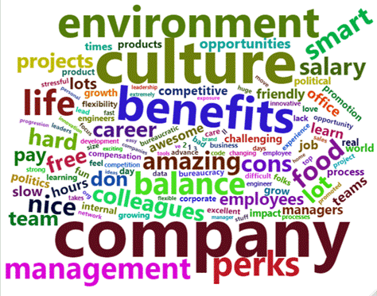
Word Cloud
Google
文字添加
此处
See next slide for other examples…

Slide 13
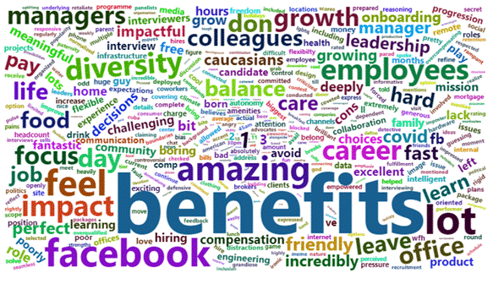
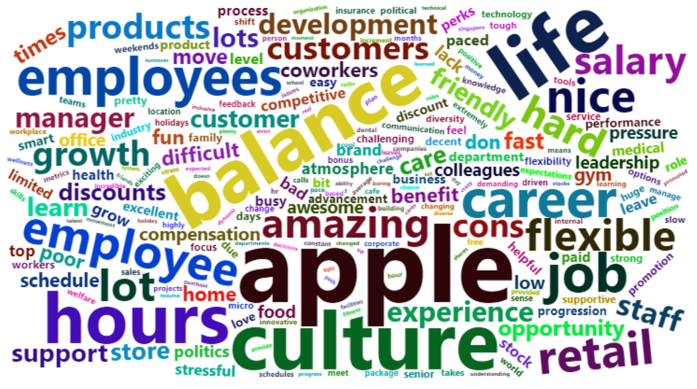
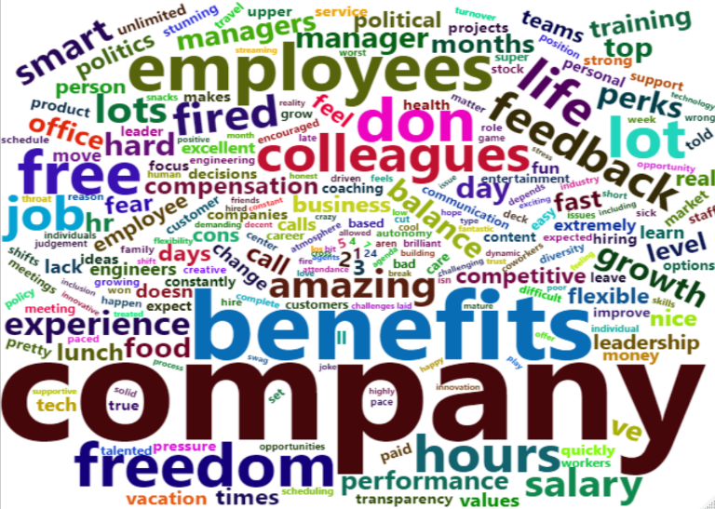
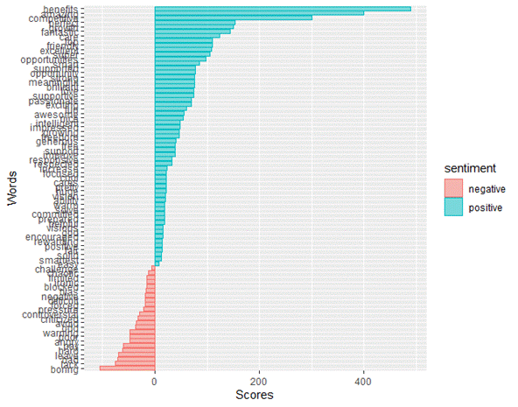
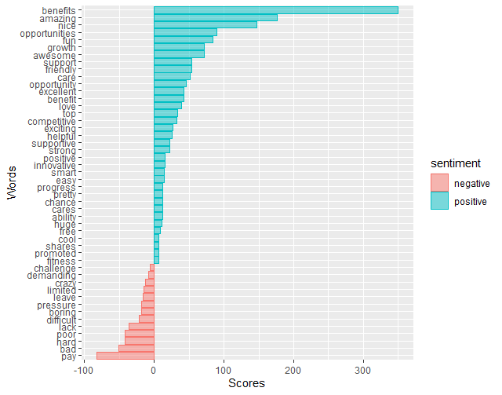
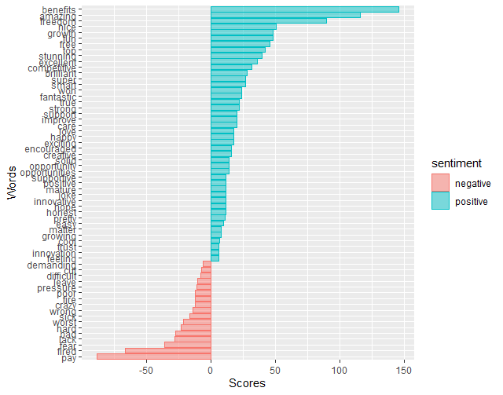
Facebook
Apple
Netflix

Slide 14
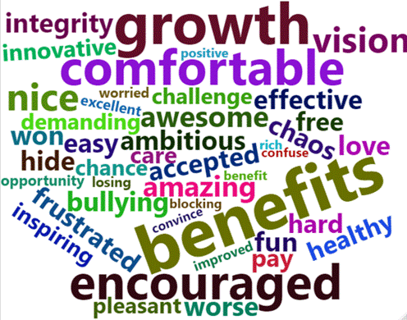
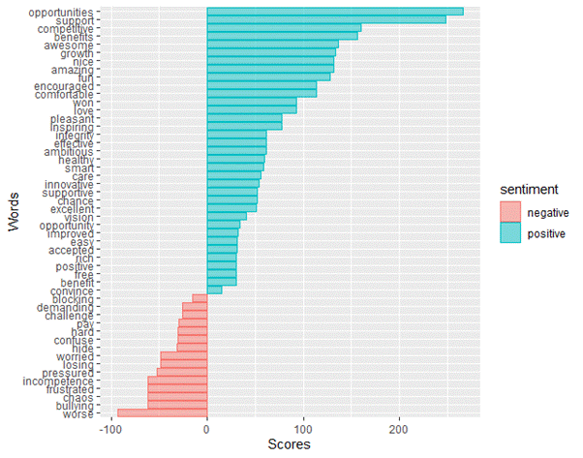
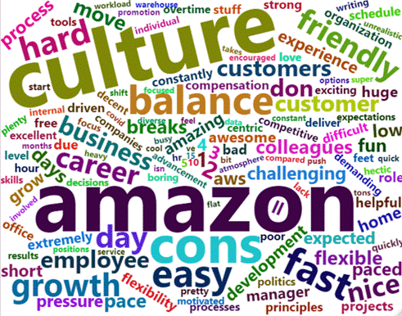
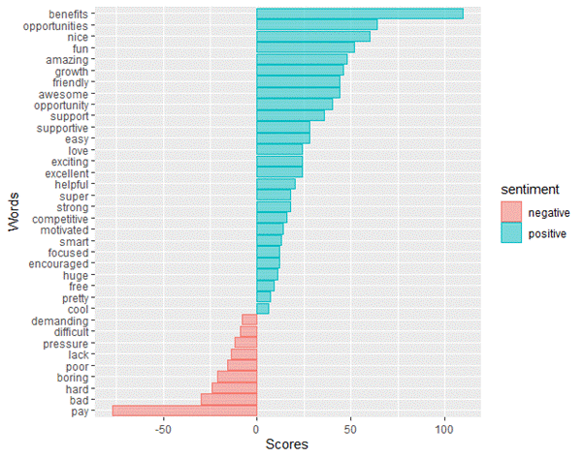
Microsoft
Amazon

Slide 15
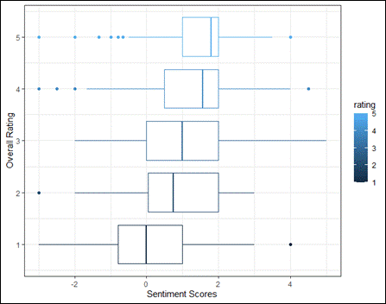
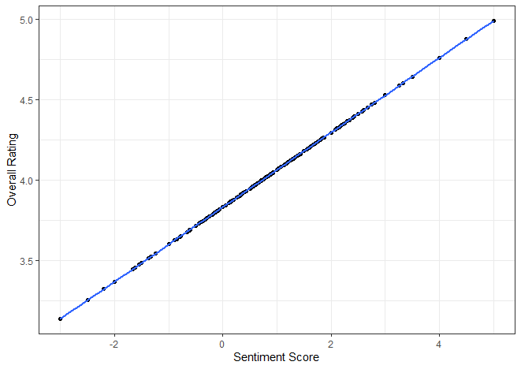
Linear Regression
With the mean of the sentiment scores closer to +2, ratings are more likely to be closer to 5.
With lower mean sentiment scores closer to 0, ratings are more likely to be to be closer to 1.
Higher sentiment scores lead to higher overall ratings and vice versa.

Slide 16
Conclusion
Overall ratings: Culture has most significant impact overall rating
Sentiment: The higher the sentiment scores, the higher the overall rating.
PART
05
Purpose
Individuals | Companies
Decide what they value the most and not rely on overall rating. | Focus on “Culture and “Opportunities”to increase overall ratings hence rankings to gain greater visibility and attract better talents Look into aspects which they are lacking e.g. “bullying”
Notes:
In conclusion, “Culture” and “Career Opportunities” factors have the greatest impact on overall rating. Further analysis of sentiment analysis revealed that FANMAG does not deviate much from the mean sentiment scores, with Facebook attaining greater positive impact on company overall ratings.
For individuals, they can decide what they value the most and not rely on the overall rating as it is impacted most heavily by “Culture” and “Career Opportunities” factors. For example, if they value opportunities, they should look beyond solely the overall ratings and focus on the word cloud and the rating for greater insight into their company choice. For instance, “opportunities” occurred frequently with a high impact score for Microsoft and this might pose as a good fit for this individual.
For the 3 companies not in the top 100, they can look to focus on “Culture” and “Career Opportunities” factors to increase their overall rating and hence ranking in the near term to gain greater visibility and potentially attract better talents. For the 3 companies currently in the top 100, they can instead look beyond their overalls ratings and focus on the aspects which are lacking which contribute less to their overall ratings. For example, Microsoft has a huge proportion of negative sentiments of “bullying” and they can look to improve their ratings for “senior management”.

Slide 17
PART
06
Demo of RShiny

Slide 18
2030
Q&A

